Slide 1

University of Houston Downtown
College of Sciences and Technology
Masters of Science in Data Analytics
Rebuilding Weather Station Database in Texas Using SQL Queries
Presented by :
Charaf Lachouri
Mentored by :
Dr. Ling Xu
December 1st 2023

Slide 2
Start
Chapitre 1
Chapitre 2
Chapitre 3
Chapitre 4
The Presentation Plan
Introduction
état de l’art

Slide 3
Start
Part 1
Chapitre 2
Chapitre 3
Chapitre 4
Fin
The Presentation Plan
Introduction
Current Database Challenges

Slide 4
Start
Part 1
Part 2
Chapitre 3
Chapitre 4
Fin
The Presentation Plan
Introduction
Current Database Challenges
Database Restructuring with SQL Queries

Slide 5
Start
Part 1
Part 2
Part 3
Chapitre 4
Fin
The Presentation Plan
Introduction
Current Database Challenges
Database Restructuring with SQL Queries
Benefits, Challenges, and Next Steps

Slide 6
Start
Part 1
Part 2
Part 3
End
The Presentation Plan
Introduction
Current Database Challenges
Database Restructuring with SQL Queries
Benefits, Challenges, and Next Steps
Conclusion

Slide 7
Start
This project aims to enhance the accessibility and usability of a weather station database by restructuring it with SQL queries, providing a more detailed and comprehensible format for efficient management by administrators, seamless operation by operators, and improved understanding for regular end users.
Introduction
Mission Statement
Mission Objectives

Slide 8
Start
Introduction
“What do we need to optimize the weather station database through strategic SQL query restructuring, fostering accessibility, clarity, and usability for administrators, operators, and end users alike."
Mission Statement
Mission Objectives

Slide 9
Start
Introduction
Enhance Data Accessibility
Improve Data Clarity and Detail
Facilitate User-Friendly Interaction
Ensure Database Integrity
Enable Adaptive Database Structures
Mission Statement
Mission Objectives

Slide 10
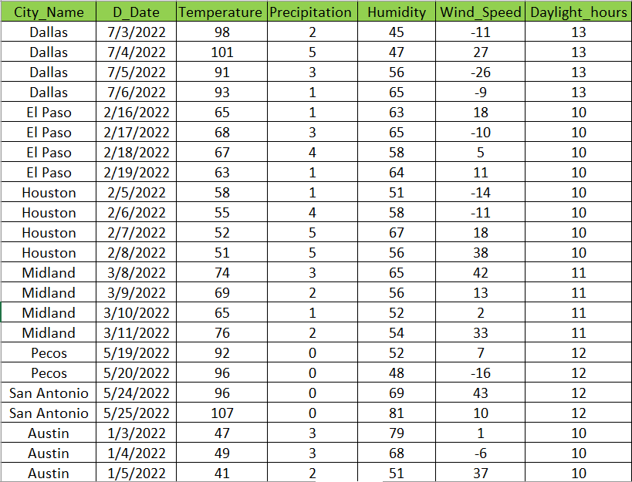
Start
Part 1
Part 2
Part 3
End
Current Database Challenges and Limitations
Data Source : 1. National Weather Service (www.weather.gov)
2. National Oceanic Atmospheric Administration (NOAA)

Slide 11
Start
Part 1
Part 2
Part 3
End
Limited Details of Data
Inefficient Query Performance
Lack of User-Friendly Interfaces
Limited Historical Data Analysis
Scalability Challenges
Current Database Challenges and Limitations

Slide 12
Start
Part 1
Part 2
Part 3
End
Database Restructuring with SQL Queries
Retrieve weather data for Houston on 8/8/2022 with temperature descriptions and heat index
Get the average temperature, precipitation, humidity, wind speed, and daylight hours for Dallas with descriptions

Slide 13
Start
Part 1
Part 2
Part 3
End
Find the cities where the temperature was within 5 degrees Fahrenheit of the average temperature for the entire dataset on a 2/18/2022 with descriptions
Database Restructuring with SQL Queries

Slide 14
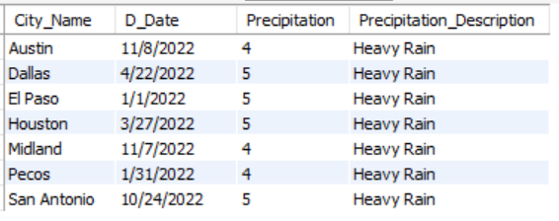
Start
Part 1
Part 2
Part 3
End
Find the days with the highest precipitation for each city
Database Restructuring with SQL Queries

Slide 15
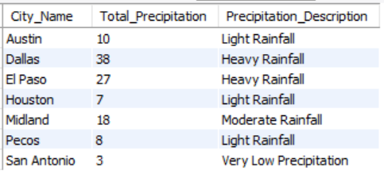
Start
Part 1
Part 2
Part 3
End
Calculate the total precipitation for each city in January
Database Restructuring with SQL Queries

Slide 16
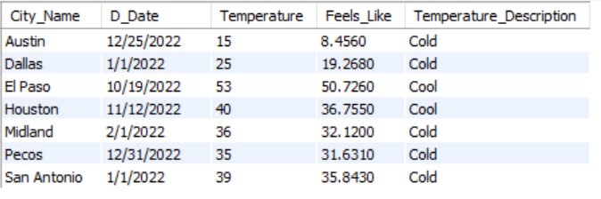
Start
Part 1
Part 2
Part 3
End
Retrieve the date and temperature for the coldest day in each city with descriptions and heat index
Database Restructuring with SQL Queries

Slide 17
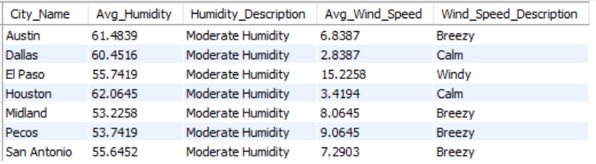
Start
Part 1
Part 2
Part 3
End
Find the average humidity and wind speed for each city in March
Database Restructuring with SQL Queries

Slide 18
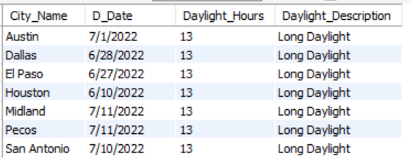
Start
Part 1
Part 2
Part 3
End
Retrieve the date and daylight hours for the day with the longest daylight in each city
Database Restructuring with SQL Queries

Slide 19
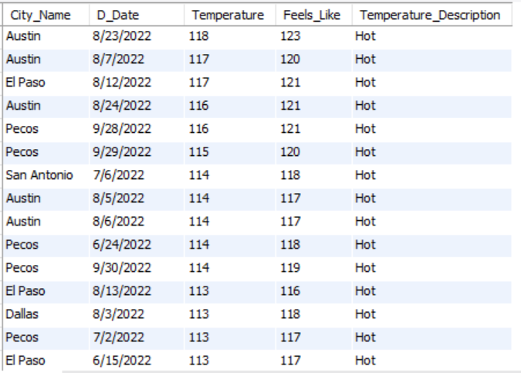
Start
Part 1
Part 2
Part 3
End
Find the cities and dates where the temperature exceeded 110 degrees Fahrenheit
Database Restructuring with SQL Queries

Slide 20
Start
Part 1
Part 2
Part 3
End
Benefits, Challenges, and Next Steps
Benefits
Enhanced Data Accuracy
Improved Decision-Making
User Empowerment and Understanding
Efficient Data Visualization
Adaptability to Future Needs
Streamlined Operational Processes
Enhanced Forecasting Accuracy
Cost Savings through Resource Optimization
Implementation Challenges
Perspectives

Slide 21
Start
Part 1
Part 2
Part 3
End
Benefits, Challenges, and Next Steps
Benefits
Data Migration Complexity
Ensuring Data Consistency
User Training and Adoption
Performance Optimization
Integration with Existing Systems
Security and Data Privacy Concerns
Budget and Resource Constraints
Minimizing Downtime
Implementation Challenges
Perspectives

Slide 22
Start
Part 1
Part 2
Part 3
End
Benefits, Challenges, and Next Steps
Benefits
Pilot Implementation and Testing
User Training and Communication
Continuous Monitoring and Optimization
Feedback Collection and Iterative Refinement
Scalability Planning and Future Development
Implementation Challenges
Perspectives

Slide 23
Start
Part 1
Part 2
Part 3
End
In conclusion, our optimized weather database, achieved through strategic SQL query restructuring, brings heightened data accuracy, streamlined processes, and improved user empowerment. With ongoing commitment to improvement and a dynamic platform, featuring user-friendly interfaces, this system not only addresses current challenges but also lays the foundation for future advancements in weather data management.
Conclusion

Slide 24
Thanks for your attention!!!!
Questions !!!

